Slide 1




UE20CS302 – Machine Intelligence
Mini Project
Water Quality Prediction Analysis
Team No: 25
Project Guide : Dr. ARTI ARYA
TARUN S : PES2UG20CS474

Slide 2

Problem Statement
Various contaminants, threatened water quality in recent years. Predicting and model construction for checking water quality have become crucial to control water pollution.
Water quality prediction has more practical significance not only for the management of water
resources but also for the prevention of water pollution.
This project aims to measure water quality using machine learning techniques. The potability of a body of water is measured by a numerical phrase. The following water quality parameters were utilized to assess the overall water quality in terms of potability in this study. pH, Hardness, Solids, Sulfate, Conductivity, Organic Carbon, Trihalomethanes, Turbidity were the parameters.
To depict the water quality, these parameters are used as a feature vector. To estimate the water quality class, the following classification algorithms: Logistic Regression, Decision Tree (DT), K- Nearest Neighbor (KNN),Support Vector Machine and Random Forest

Slide 3
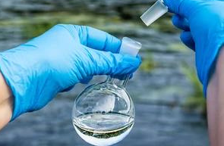
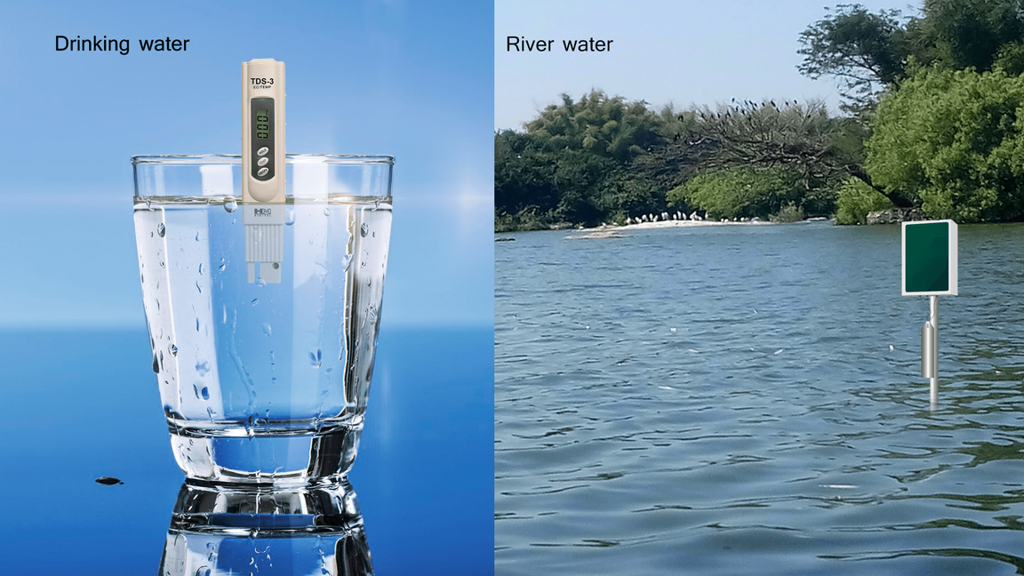
Application and Uses
Predicting water quality is one of the applications of our project Water Quality Prediction.
It tells whether water is suitable for Human consumption or not.
It also tells us about Biochemical oxygen Demand of water in Rivers, lakes and seas , whether the water is suitable for the Aquatic habitat or not.
Bad quality water can have adverse impacts on human health and can cause risk of developing ceratin diseases.

Slide 4
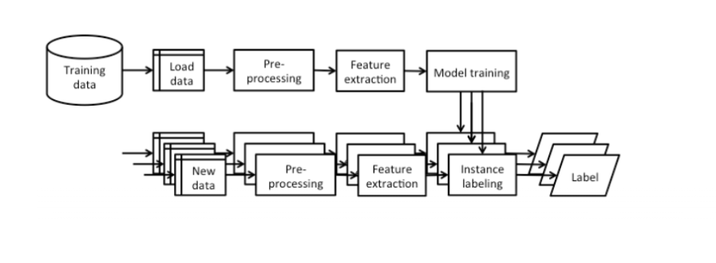
High level Architecture

Slide 5


LITERATURE SURVEY- PES2UG20CS480
Title of the paper | Year of Publication | Journal/Conference Name | Advantages | Limitations
Nexus of Water Quality prediction by ANN | 2022 | Talluru Tejaswi;Challapalli Manoj;Pepella Venkata Daivakeshwar Naidu;Tekkala Santhosh;Polaki Venkata Sai Akhil;Vithya Ganesan 2022 International Conference on Innovative Computing, Intelligent Communication and Smart Electrical Systems (ICSES) | Furthermore, based to the MSE values, the LSTM model performed somewhat better than the NARNET model in general | However, NARNET model performed better with R % greater than 93.93
Water quality prediction method based on LSTM neural network | 2017 | Yuanyuan Wang;Jian Zhou;Kejia Chen;Yunyun Wang;Linfeng Liu 2017 12th International Conference on Intelligent Systems and Knowledge Engineering | LSTM NN has been relatively stable which always be the smallest with each time step | LTSM Requires more memory and time to train
A Tensor Model for Quality Analysis in Industrial Drinking Water Supply System | 2019 | Di Wu;Hao Wang;Razak Seidu 2019 IEEE Intl Conf on Dependable, Autonomic and Secure Computing, Intl Conf on Pervasive Intelligence and Computing, Intl Conf on Cloud and Big Data Computing, Intl Conf on Cyber Science and Technology Congress (DASC/PiCom/CBDCom/CyberSciTech) | We have evaluated the general accuracy using RMSE, it ranges from 0.22 to 0.55. Coliform has better prediction accuracy. | Clostridium perfringens is the worst. The reason behind this must be explained by domain experts
 |  |  |  | reason behind needs to be interpreted by domain experts

Slide 6
LITERATURE SURVEY- PES2UG20CS468
Title of the paper | Year of Publication | Journal/Conference Name | Advantages | Limitations
Prediction of water quality using Naive Bayesian algorithm | 2016 | P. Varalakshmi;S. Vandhana;S. Vishali 2016 Eighth International Conference on Advanced Computing (ICoAC) | The new prediction model is a more effective method for the water quality prediction, which can provide a reliable scientific guarantee for the further use of the recycled water. | .
A Back Propagation Neural Network Model based on kalman filter for water quality prediction | 2015 | Yanfei Zhao;Zhihong Zou;Shenglong Wang 2015 11th International Conference on Natural Computation (ICNC) | . It is highly adaptable and efficient and does not require any prior knowledge about the network. | Data mining is sensitive to noise and irregularities
Predictive Models for River Water Quality using Machine Learning and Big Data Techniques - A Survey | 2021 | Jitha P Nair;M S Vijaya 2021 International Conference on Artificial Intelligence and Smart Systems (ICAIS) | Various time series analysis, machine learning and deep learning techniques involved in identifying and evaluating the quality of the water | Lack of Quality Data. Inadequate Infrastructure.

Slide 7
LITERATURE SURVEY- PES2UG20CS474
Title of the paper | Year of Publication | Journal/Conference Name | Advantages | Limitations
Prediction of Water Quality using Artificial Neural Network | 2022 | J. Priskilla Angel Rani;R. Sujeethra;C. Yesubai Rubavathi 2022 4th International Conference on Smart Systems and Inventive Technology (ICSSIT) | higher accuracy using MICE than ann with unfilled data. | high computation time with high iterations to fill up missing data
An Intelligent System on Water Quality Remote Monitor and Water Bloom Prediction | 2010 | Xiao-yi Wang;Ji-ping Xu;Zai-wen Liu;Jun Dai;Shi-ping Zhu 2010 International Conference on Measuring Technology and Mechatronics Automation | real time water monitoring using hybrid programming using vb and matlab . providing higher prediction accuracy. | low model precision fo 0.0002
Water Quality Prediction for Smart Aquaculture Using Hybrid Deep Learning Models | 2022 | K. P. Rasheed Abdul Haq;V. P. Harigovindan IEEE Access | Results show that the CNN-LSTM hybrid model pro- vides signi?cant improvement in prediction accuracy as well as computation time compared to the baseline DL models. | Complicated architecture Unknown optimal number of clusters

Slide 8
Proposed Approach
The dataset for our model consists of 10 features. Data pre-processing is done by considering 67% as training data and 33% test data
Feature Scaling has been done to normalize the data and remove the outliers accordingly.
We have used Five Machine learning Models for Prediction namely- Logistic Regression , Decision Tree, Support Vector Machine, K-Nearest Neighbours and Random Forest. Accuracy, Precision, Recall and F1 score are calculated. Confusion Matrix is also plotted
A Predictive Model has been built to predict Potability depending upon the other features using an ML model Support Vector Machine.

Slide 9
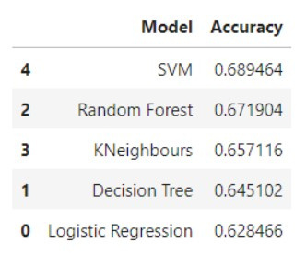
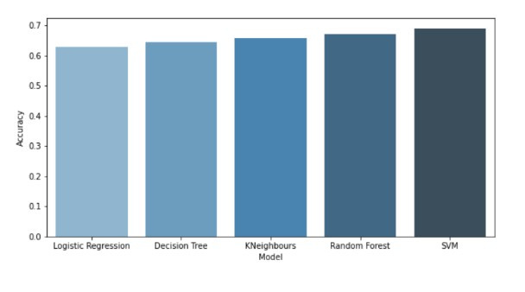
Results and Discussion
The following accuracies has been obtained with respect to the following Machine learning Algorithms:

Slide 10
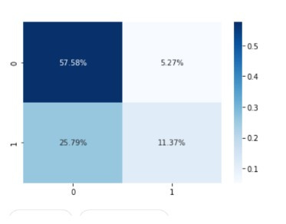
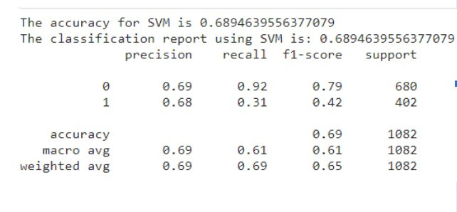
Conclusion
SVM [Support Vector Machine] has the best accuracy among all the ML models used. It has an accuracy of 68.9464%. The Confusion matrix and the classification report is given below

Slide 11
References
[1]Nexus of Water Quality prediction by ANN -Talluru Tejaswi;Challapalli Manoj;Pepella Venkata Daivakeshwar Naidu;Tekkala Santhosh;Polaki Venkata Sai Akhil;Vithya Ganesan
[2]Water quality prediction method based on LSTM neural network -Yuanyuan Wang;Jian Zhou;Kejia Chen;Yunyun Wang; Linfeng Liu
[3]A Tensor Model for Quality Analysis in Industrial Drinking Water Supply System- Di Wu;Hao Wang;Razak Seidu
[4]Prediction of water quality using Naive Bayesian algorithm P. Varalakshmi;S. Vandhana;S. Vishali
[5]A Back Propagation Neural Network Model based on kalman filter for water quality prediction Yanfei Zhao;Zhihong Zou;Shenglong Wang
[6]Predictive Models for River Water Quality using Machine Learning and Big Data Techniques - A Survey Jitha P Nair;M S Vijaya

Slide 12

References
[7]Prediction of Water Quality using Artificial Neural Network- J. Priskilla Angel Rani;R. Sujeethra;C. Yesubai Rubavathi
[8]An Intelligent System on Water Quality Remote Monitor and Water Bloom Prediction Xiao-yi Wang;Ji-ping Xu;Zai-wen Liu;Jun Dai;Shi-ping Zhu
[9]Water Quality Prediction for Smart Aquaculture Using Hybrid Deep Learning Models -K. P. Rasheed Abdul Haq;V. P. Harigovindan
IEEE Access

Slide 13

THANK YOU

